Slide 1
System Development Methods CT00046-3-2
System Design – Part 1

Slide 2
Learning Outcome
At the end of the module, you should able to:
Apply UML analysis, design and implementation techniques to develop a simple prototype, with a suitable interface, from conception through to implementation.
Demonstrate a knowledge of the fundamental issues of prototyping by applying standard design principles.

Slide 3
Key Terms you must be able to use
If you have mastered this topic, you should be able to use the following terms correctly in your assignments and exams:
Design Concepts
Design Techniques
Design Tools

Slide 4
System Design
Systems Design
Process of defining the architecture, components, modules, interfaces, and data for a system to satisfy specified requirements.
Aka; System Modeling
System Design in a typical software project;
Input – System Specification
Including SRS
Output – System Design Specification.
Has details about what to design
Created by designers for programmers.

Slide 5
System Design Areas
Hi-level Design
System Architecture
Hardware, Software, Network, etc
Software Design
Software Architecture
Conceptual Design
Logical Design
Physical Design

Slide 6

System Design Objectives
To creating a solution to a problem in hand
To breakdown and understand complex concepts and process.
To create a product safe and secure for use (HCI)
To add vital details to product
To come-up with efficient and effective product / solution
To ensure product comply with set specifications and standards.
To implement modern technology into product
To test product early and avoid costly rework

Slide 7
System Architecture
A high-level view of the system where developer need to determine;
The types of users
Environment (Different ‘views’ of the system)
Behavior of the system
Availability of technology
The platform
Laws and Legislations
Industry Standards and Protocols
Security
Network and connectivity
Maintenance

Slide 8
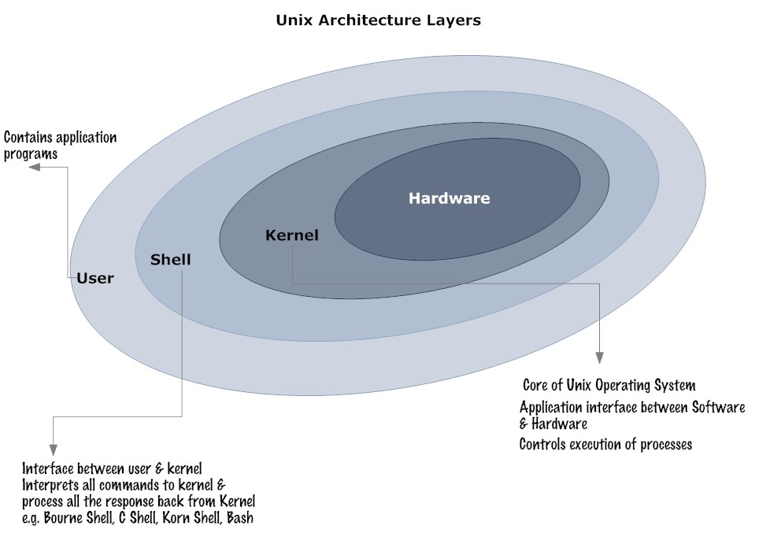
System Architecture 20-05-17 example

Slide 9
Software and Hardware Architecture
Subcomponent of System Architectures
Developers need to be concerned of;
Operating system and versions
Input / output requirements
Storage requirements
Processing requirements
Interfaces (including GUI)
Security, System control and backup or recovery
System support

Slide 10
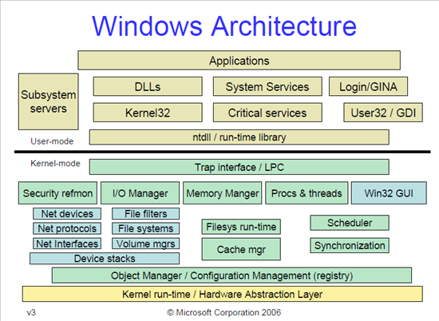
Software Architecture example

Slide 11
Conceptual Design
Understanding and presenting the concept of the product
Usually to non-IT people, users, customers, etc
Contains basic information, major process and components only.
Example (in IT) ;
Context Diagram
Use Case Diagram
Sequence Diagram
Flow Chart
Story Board
Rich Picture
Posters, etc.

Slide 12
Logical Design
Abstract of the system, usually presented in diagrams (models)
Process Design
Data Design
Example;
Data Flow Diagram
Activity Diagram
Entity Relations Diagram
UML – Use Case Diagram
UML – Class Diagrams, etc

Slide 13
Physical Design
Enhanced presentation of the design, usually graphical presentation of the product
Usually presented as;
Input-output of the system for users via GUI
Input–process-output for developers
Popular type of Physical Design
Prototype
Simulation
Animation
Video

Slide 14
What makes good design
Creativity and innovation
Finding ways / ideas to improve design
Good development tools
Using latest software to construct, test and present design
Experience
Improvement of skill
Commitment to high quality
Comply with design standards and principles
Fast changes to demand and environment
R&D

Slide 15
Good Design Practices
The design process should not suffer from "tunnel vision."
A good designer should consider alternative approaches.
The design should be traceable to the analysis model.
The design should not reinvent the wheel.
The design should be structured to accommodate change.
The design should be assessed for quality.

Slide 16
Question & Answer

Slide 17
Tutorial
Find a (simple) diagram of a popular system’s Architecture. Present the diagram in class. Explain the vital components displayed in the diagram.
List the types of design diagrams that you would choose to present the below new system to users. Explain Why? (consider types of design such as conceptual, data, process, etc)
A new e-commerce website for a local book store.
A calculator application for smartphone.
A traffic light control system.
A football game for children in a PC.

Slide 18
Next Session
System Design Tools and Techniques

